Slide 1

Setting up the AKO LDAP Connector
Presented by Michael J. Danberry
These instructions will allow you to use the AKO White pages while in Outlook.
Since the settings use your AKO account, it should still work once your AKO email is being forwarded to your mail.mil account.
LDAP=Lightweight Directory Access Protocol
Last update / review: 7 December 2013

Slide 2
Where to start the LDAP setup
Outlook 2010/2013: Click File, Info, Account Settings, Account Settings…, Address Books (tab), New…, <Go to next slide>
Outlook 2007: Click File, Data File Management, Address Books (tab), New…, <Go to next slide>
Outlook 2003: Click Tools, E-mail Accounts, Add a new directory or address book, Next, <Go to next slide>

Slide 3
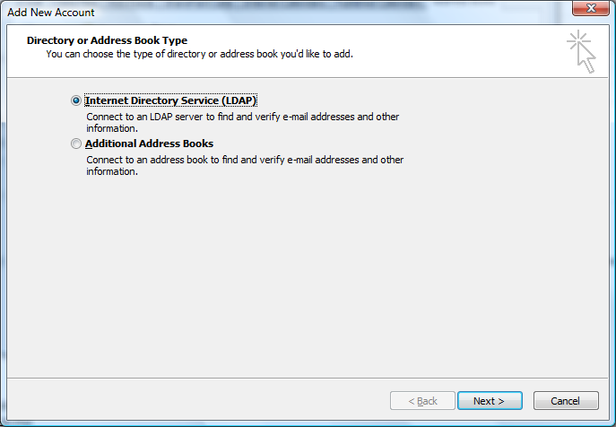
Select Internet Directory Service (LDAP)

Slide 4
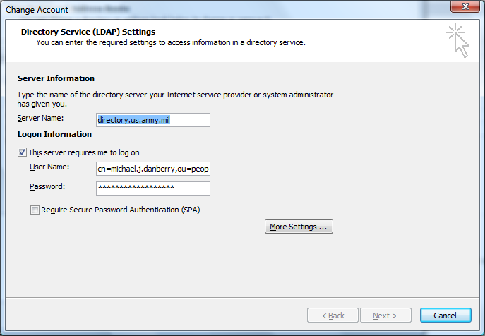
Type: directory.us.army.mil in Server Name: (AND what you see below)
Type (or copy) this in User Name:
“cn=ako.username,ou=people,ou=army,ou=dod,o=U.S. Government,c=US”
Your AKO password
Then Click Here
NOTE: ako.username = your AKO user ID

Slide 5
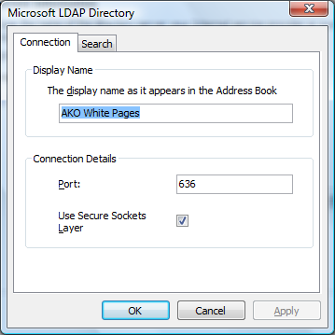
Type “AKO White Pages” in Display name box
Type 636 in Port
Check Use Secure Sockets Layer

Slide 6
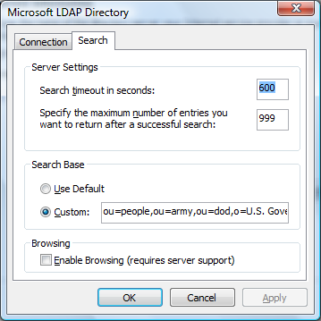
Change top box to “600” and bottom box to “999”
Type (or copy) this in Custom:
“ou=people,ou=army,ou=dod,o=U.S. Government,c=US”

Slide 7
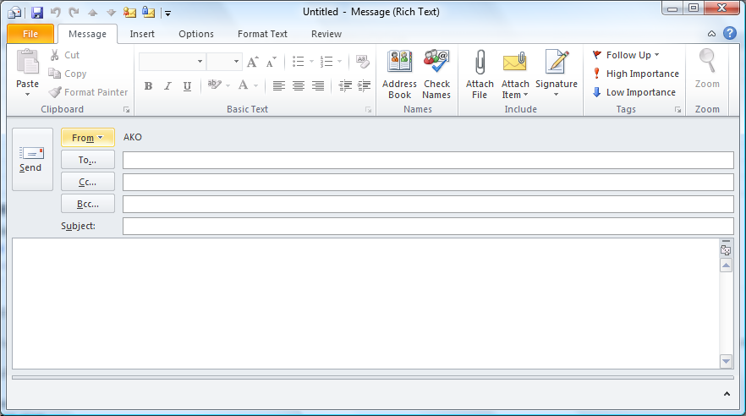
Try it now
Lastname, Firstname
Type in lastname, firstname, then press <Alt> & <k> on your keyboard, or click Check Names. That person’s AKO email address will resolve in front of your eyes. If it doesn’t, double check your password and that you typed in the LDAP connector information 100% correctly.

Slide 8
You now have a powerful address book at your fingertips
Presentation by:
Michael J. Danberry
https://MilitaryCAC.com
Further questions: https://militarycac.com/questions.htm

