Slide 1
How to export Contacts from AKO webmail to Outlook 2010, 2007, or 2013
Presented by Michael J. Danberry
Last update / review: 12 June 2015

Slide 2
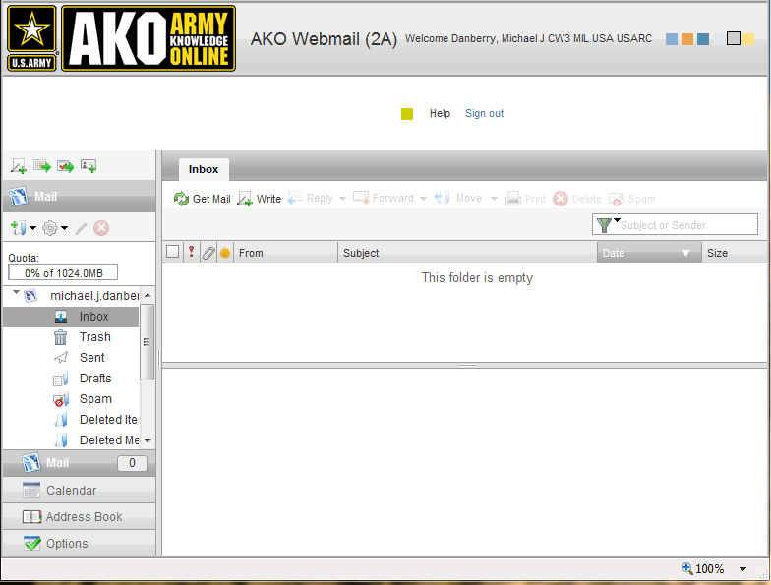
Login to: https://webmail2.us.army.mil Click Address Book

Slide 3
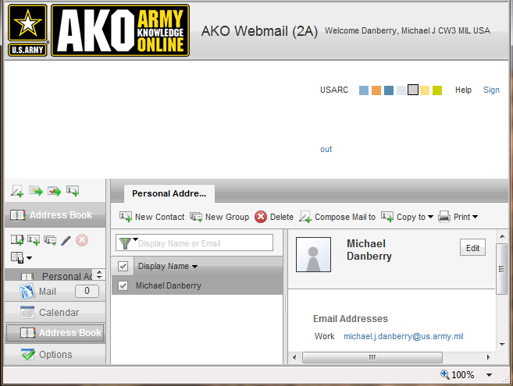

You’ll see you Personal Addre…

Slide 4
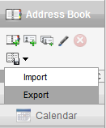
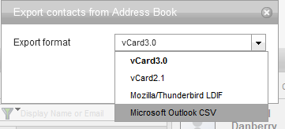
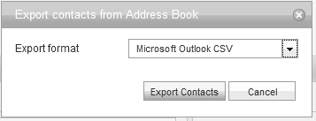
In the Address Book
Click the tiny disk, then Export
In the Export contacts from
Address Book Export format block
Select Microsoft Outlook CSV
Select Export Contacts

Slide 5
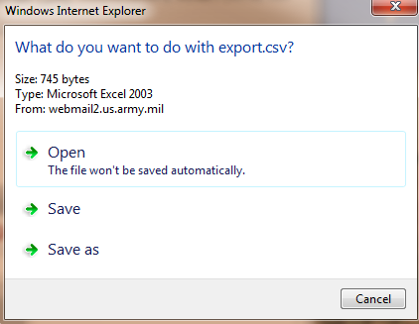
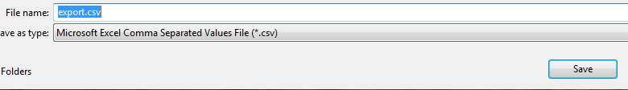
Save the file to your desktop

Slide 6


You should receive this message
Look for this icon on your desktop

Slide 7
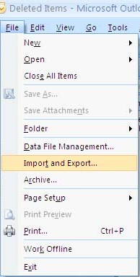
Open Outlook 2007
Click File, click Import and Export…
Now go to slide 9

Slide 8
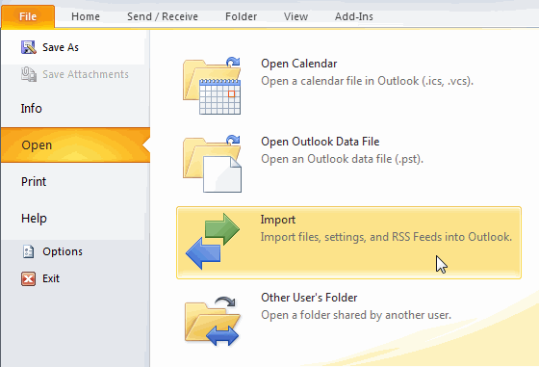
Open Outlook 2010
Click File, Choose Open, click Import

Slide 9
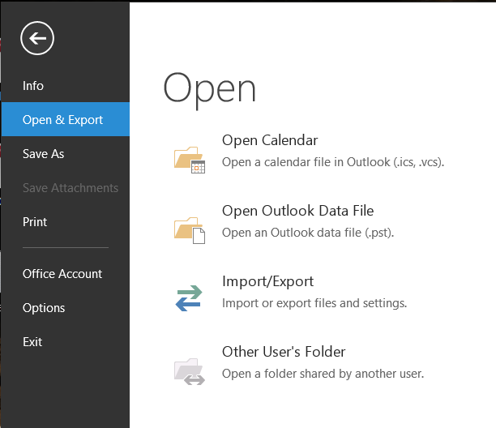
Open Outlook 2013
Click File, Choose Open & Export, click Import/Export

Slide 10
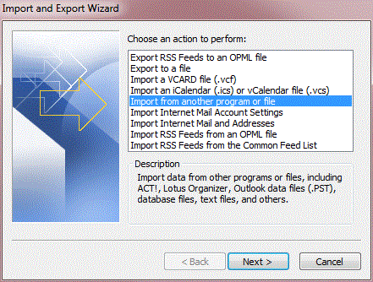
Select Import from another program or file, then Next

Slide 11
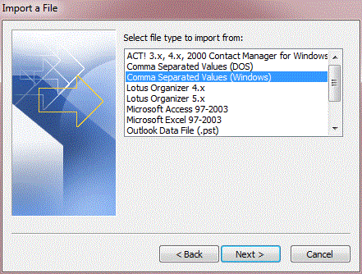
Select Comma Separated Values (Windows), then Next

Slide 12
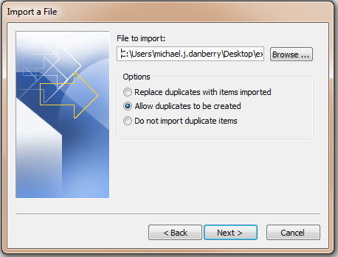
Choose Browse… to navigate to the .csv file you want to import, click Open to return to Import a File window, then select Next

Slide 13
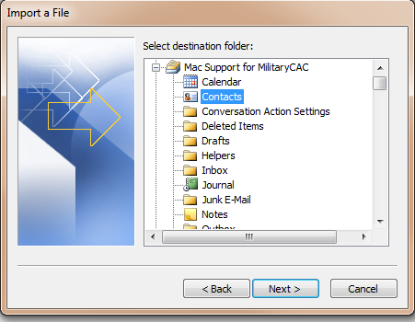
Choose Contacts as the destination folder, Click Next >

Slide 14
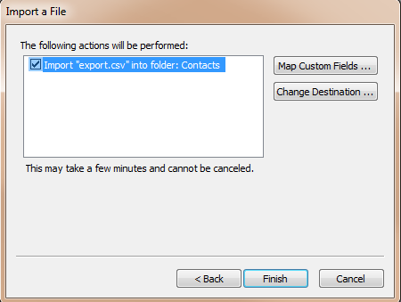
Click Finish to import the Address Book

Slide 15
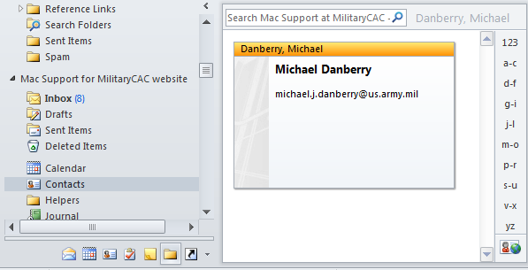
You will now see the contact in your contacts

Slide 16
Presentation created by:
Michael J. Danberry
https://MilitaryCAC.com
If you still have questions, visit: https://militarycac.com/questions.htm

